Slide 1
CNN presentation

Slide 2
Background info
Agriculture: CNNs automate plant disease and pest detection by classifying vegetables from images, aiding in crop health monitoring.
Supermarkets and Retail: CNNs streamline vegetable identification and sorting, improving inventory management and customer experience.
Food Processing: CNNs sort vegetables by type, quality, and size, ensuring consistent products in food production and packaging.

Slide 3
agenda
Data Exploration
Data Processing
Model Selection
Model Improvement
takeaways

Slide 4
DATASET EXPLORATION

Slide 5
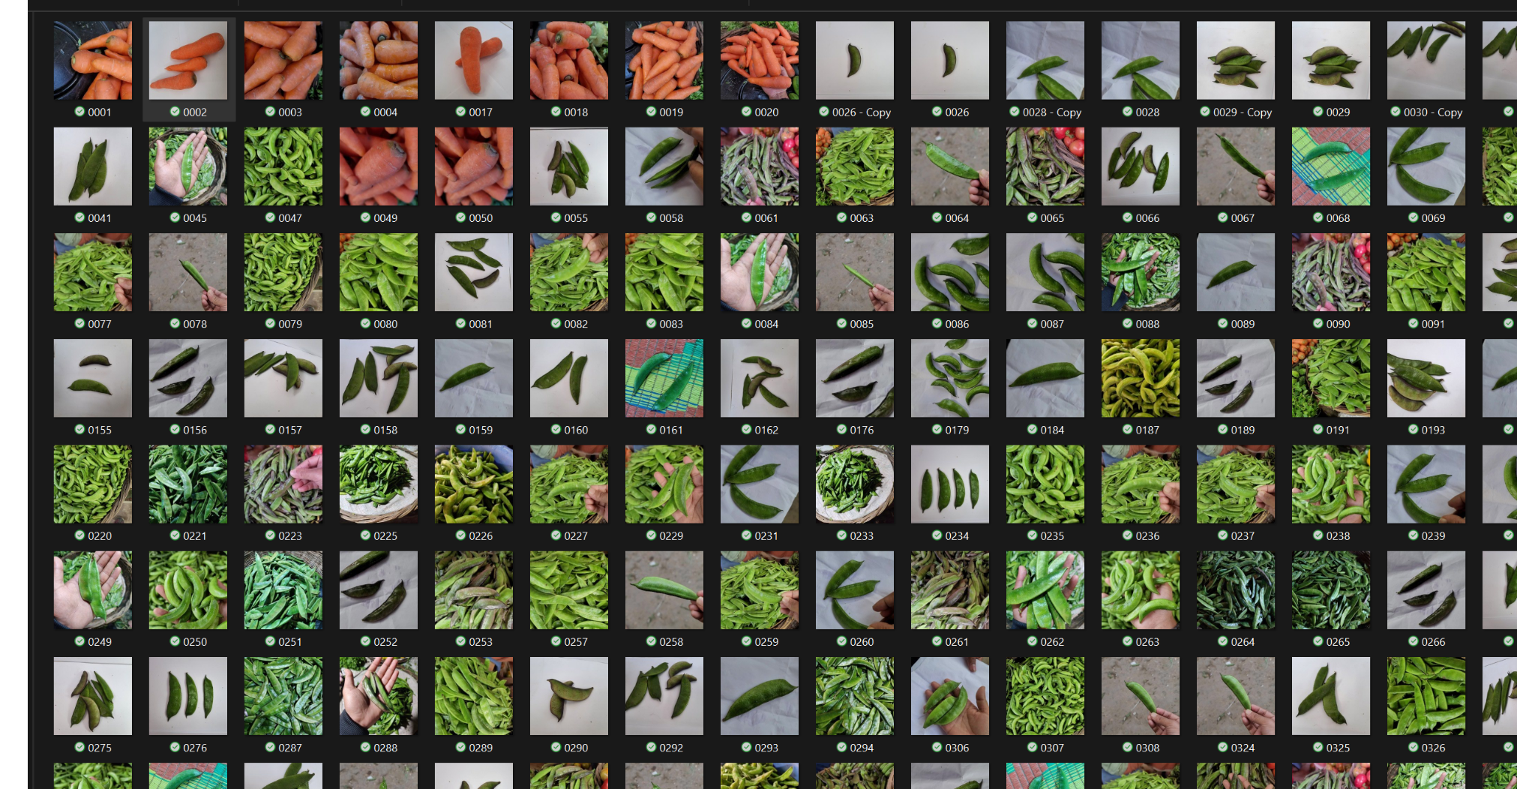
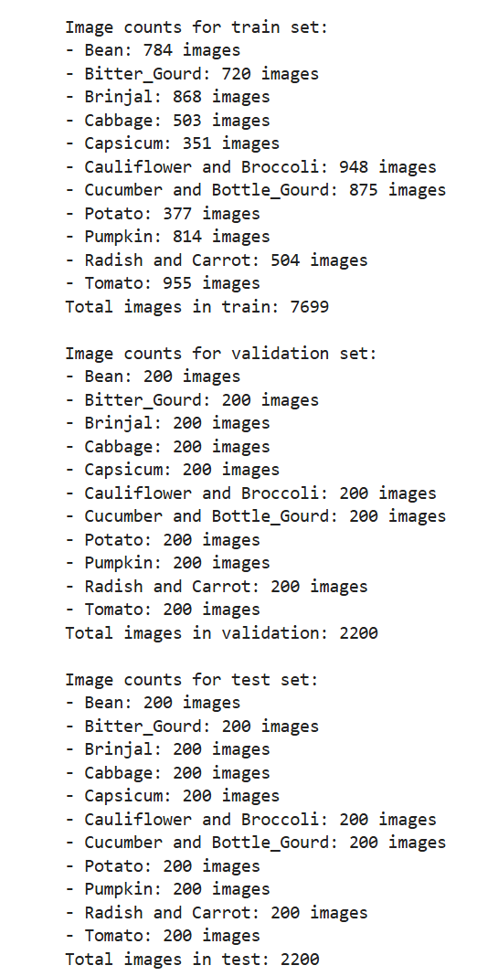
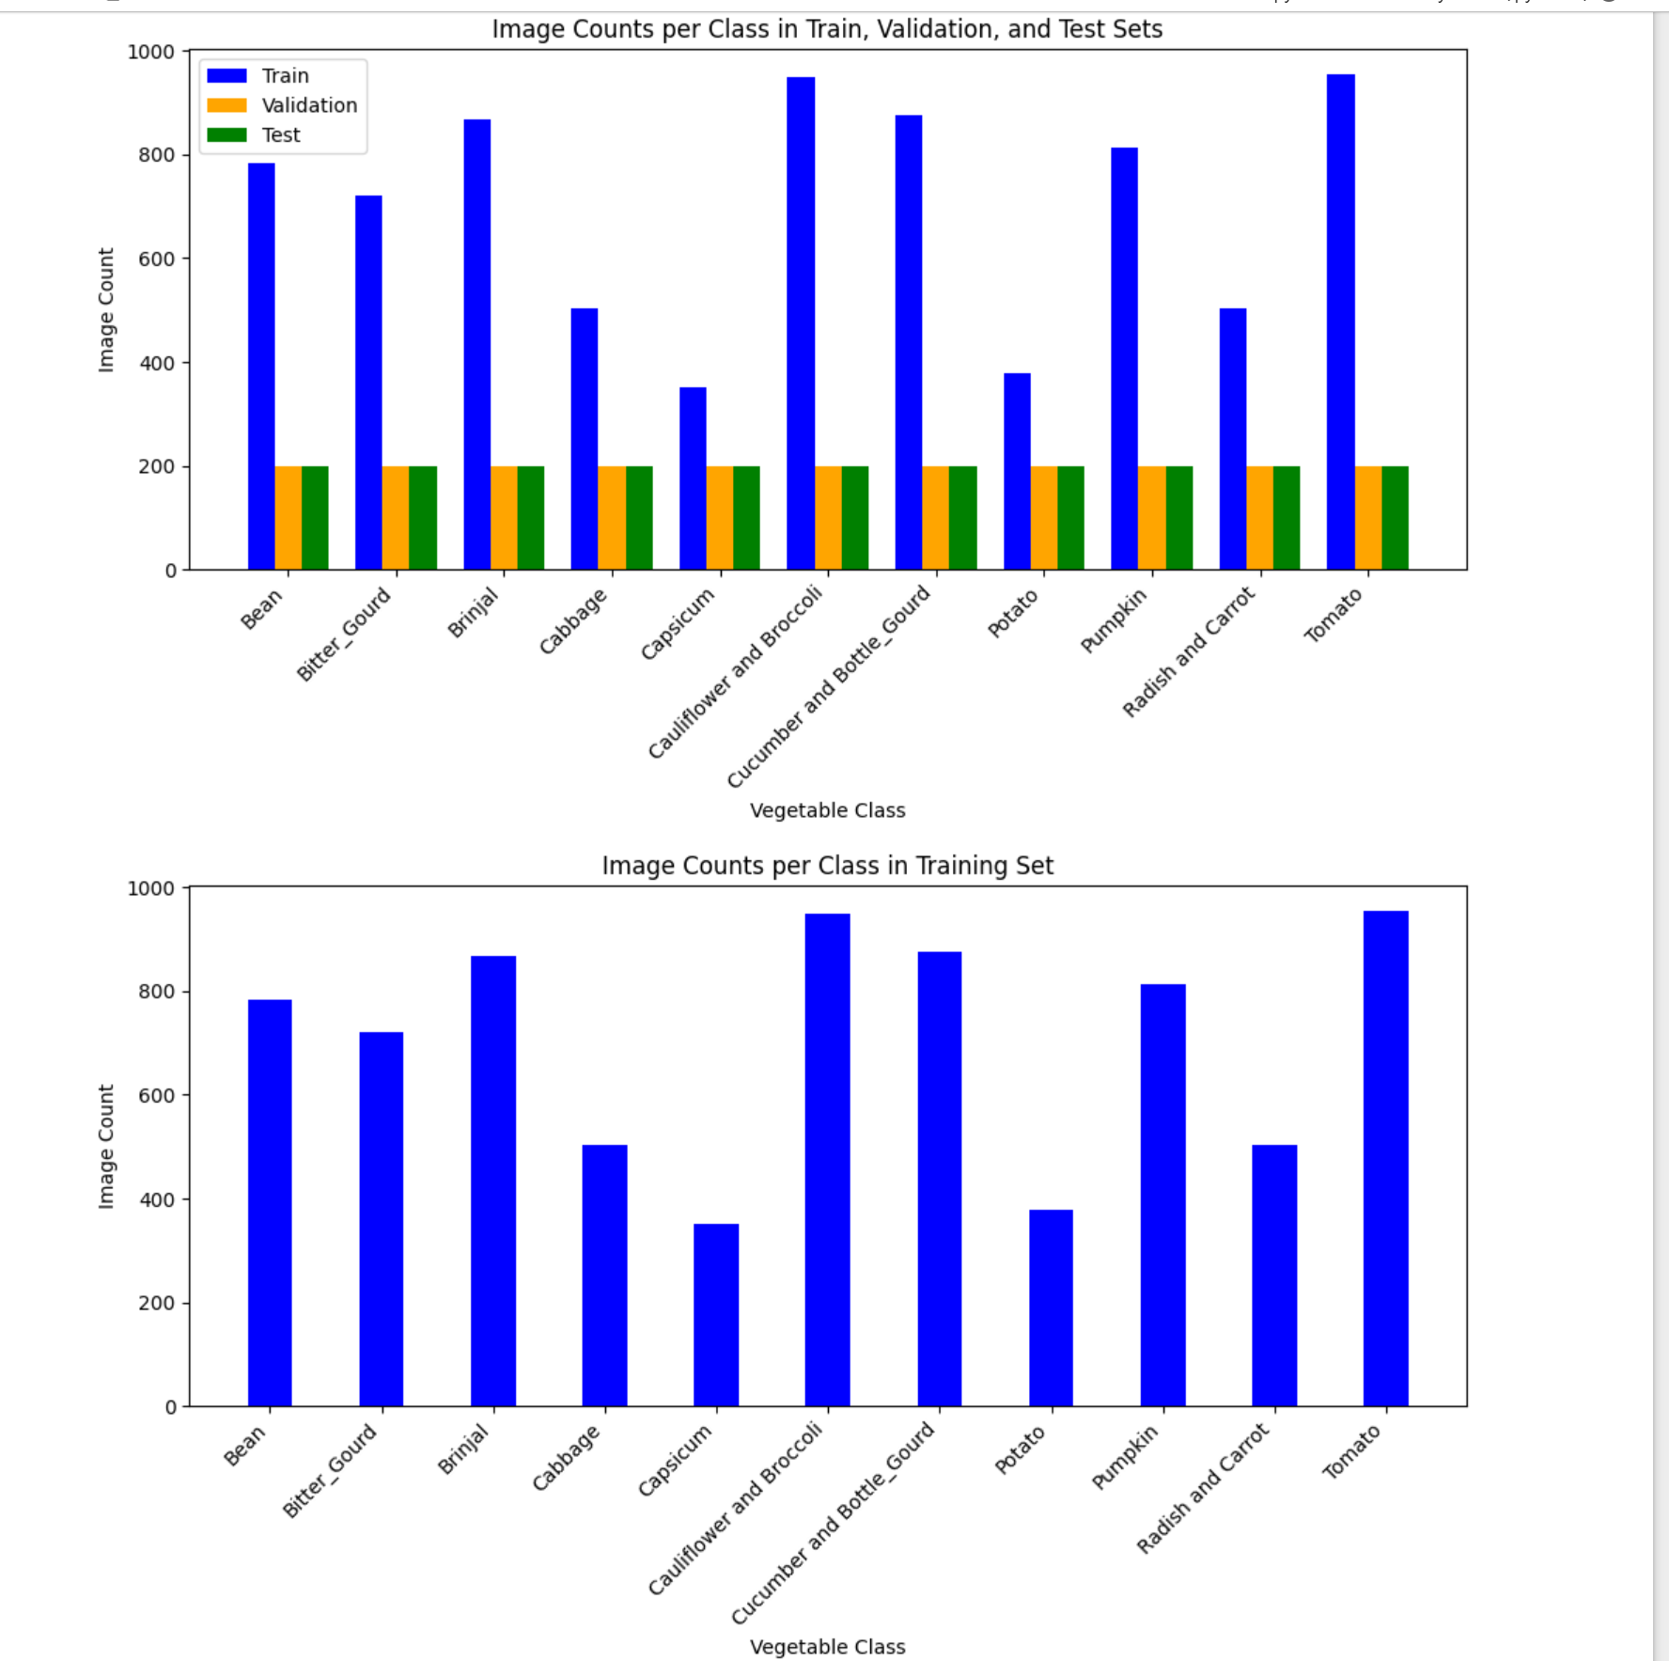
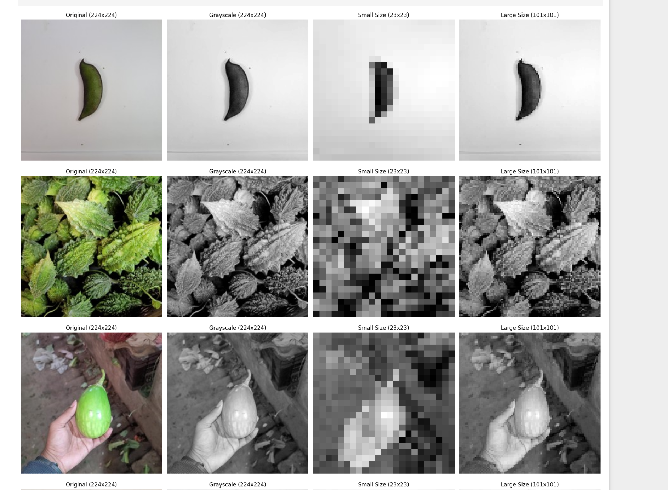
DATA INFORMATION

Slide 6
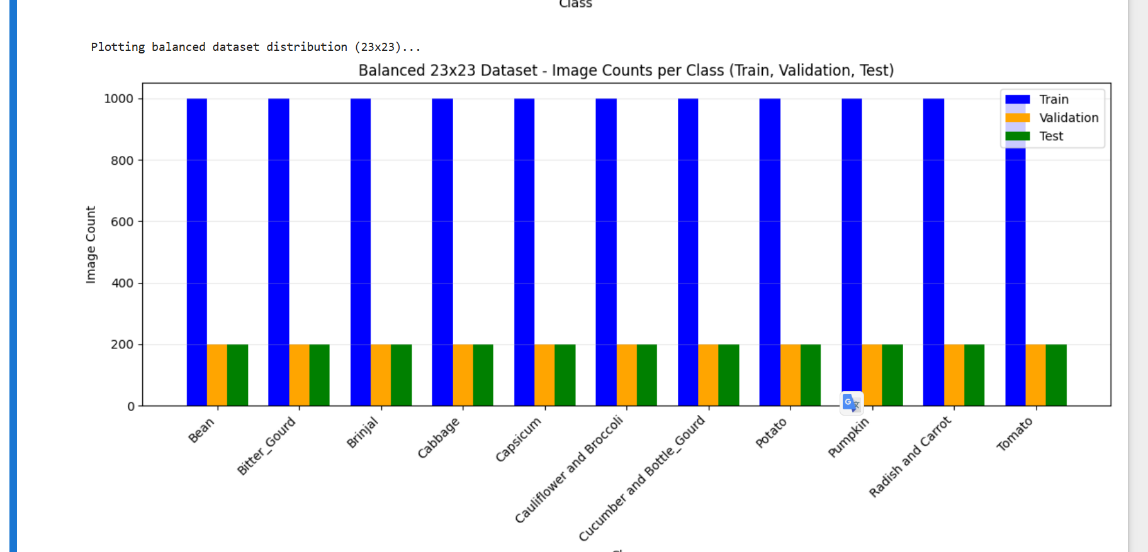
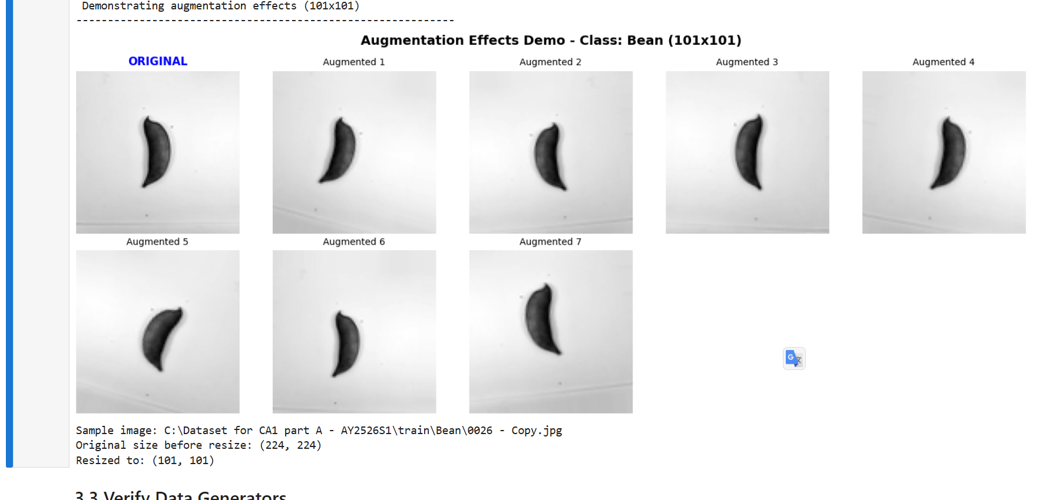
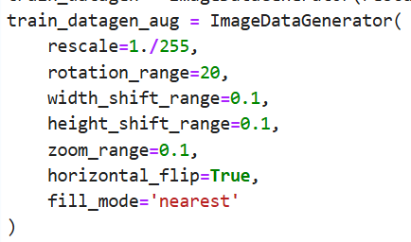
Data processing
Rename the Files to make sure they are identical
Move the pictures which are placed in the wrong folder
Resize my images to 23 and 101 size
Convert all the images to gray scale
Create two different training datasets, one with augmenting and one without for both 101 and 23
Applied augmentation and made the training dataset balanced(each have 1000 images)
Applied standardization

Slide 7
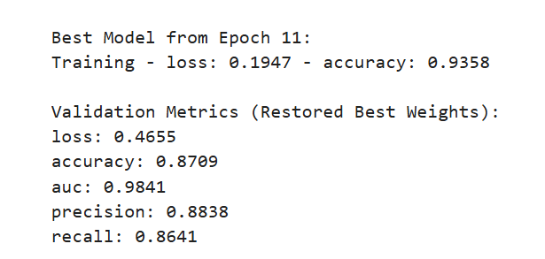
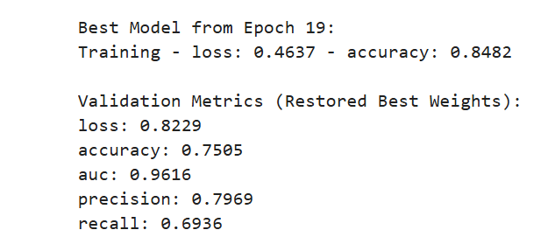
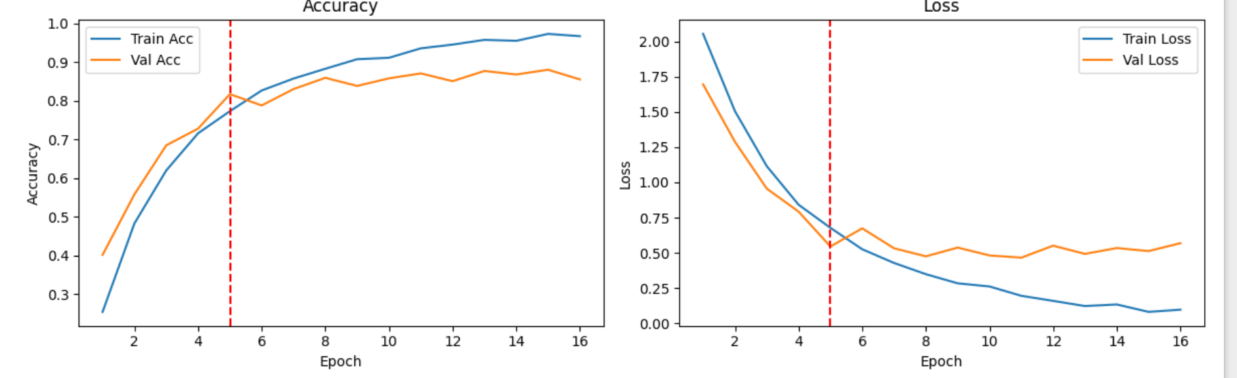
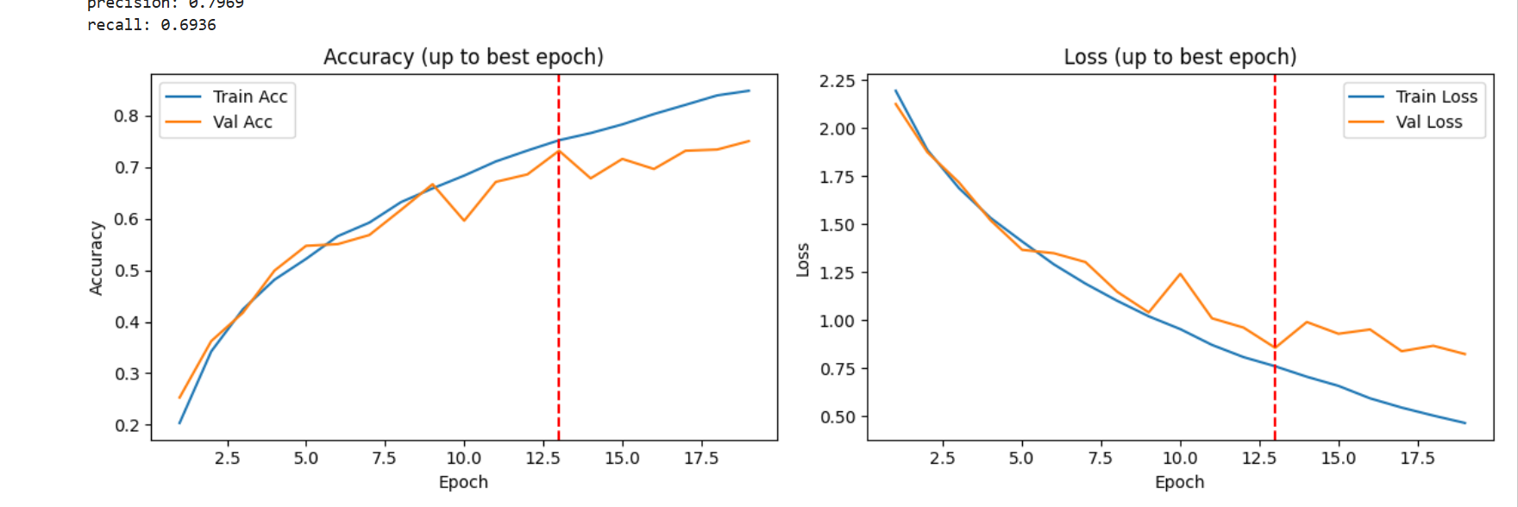
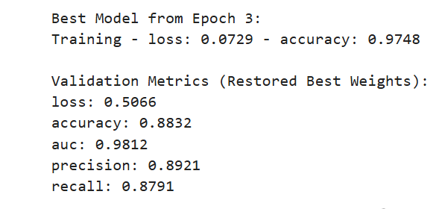
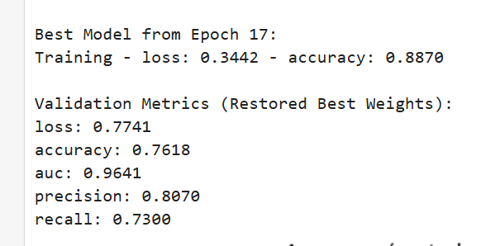
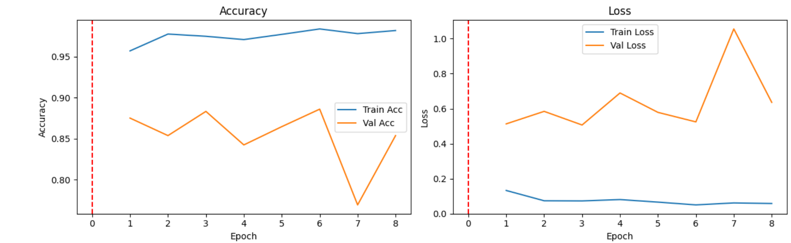
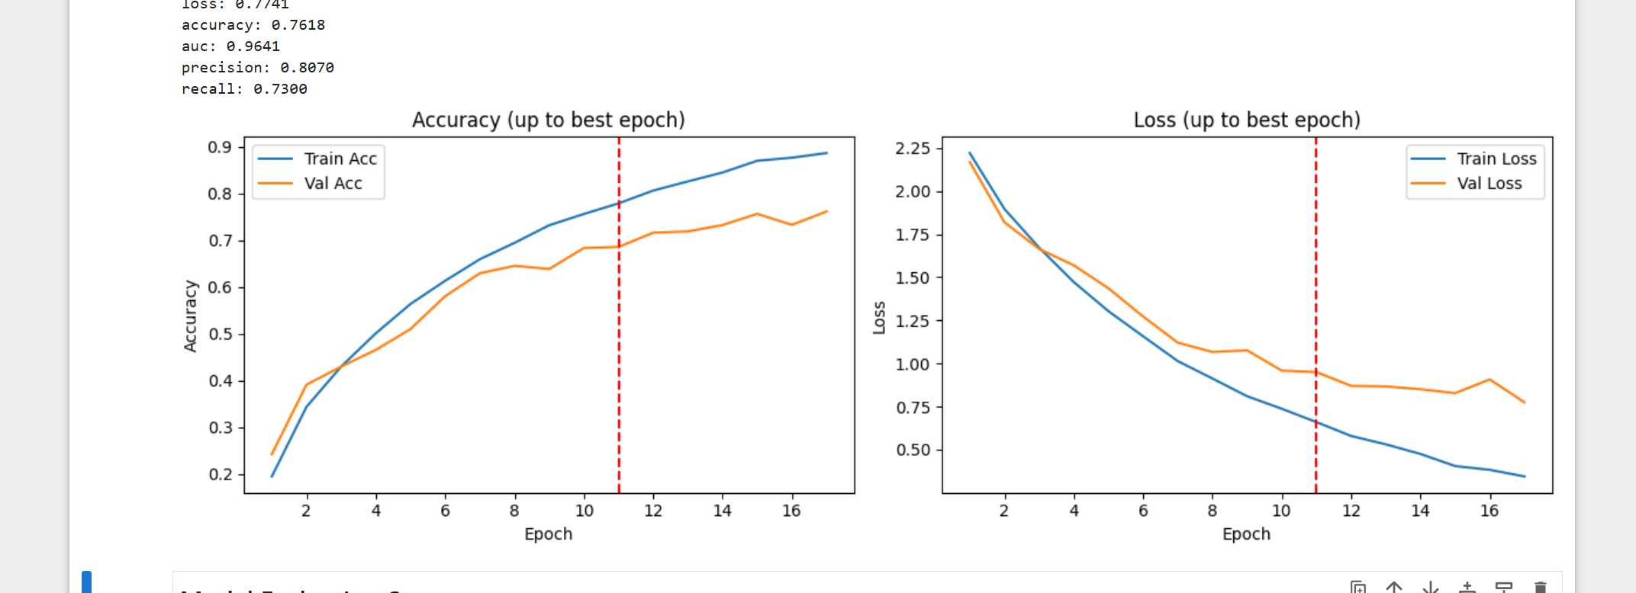
Model selection
(base line)
23
101
Augmented
Non augmented
Both overfitting with similar results. So I hypertune both augmented and non augmented for both 23 and 101

Slide 8
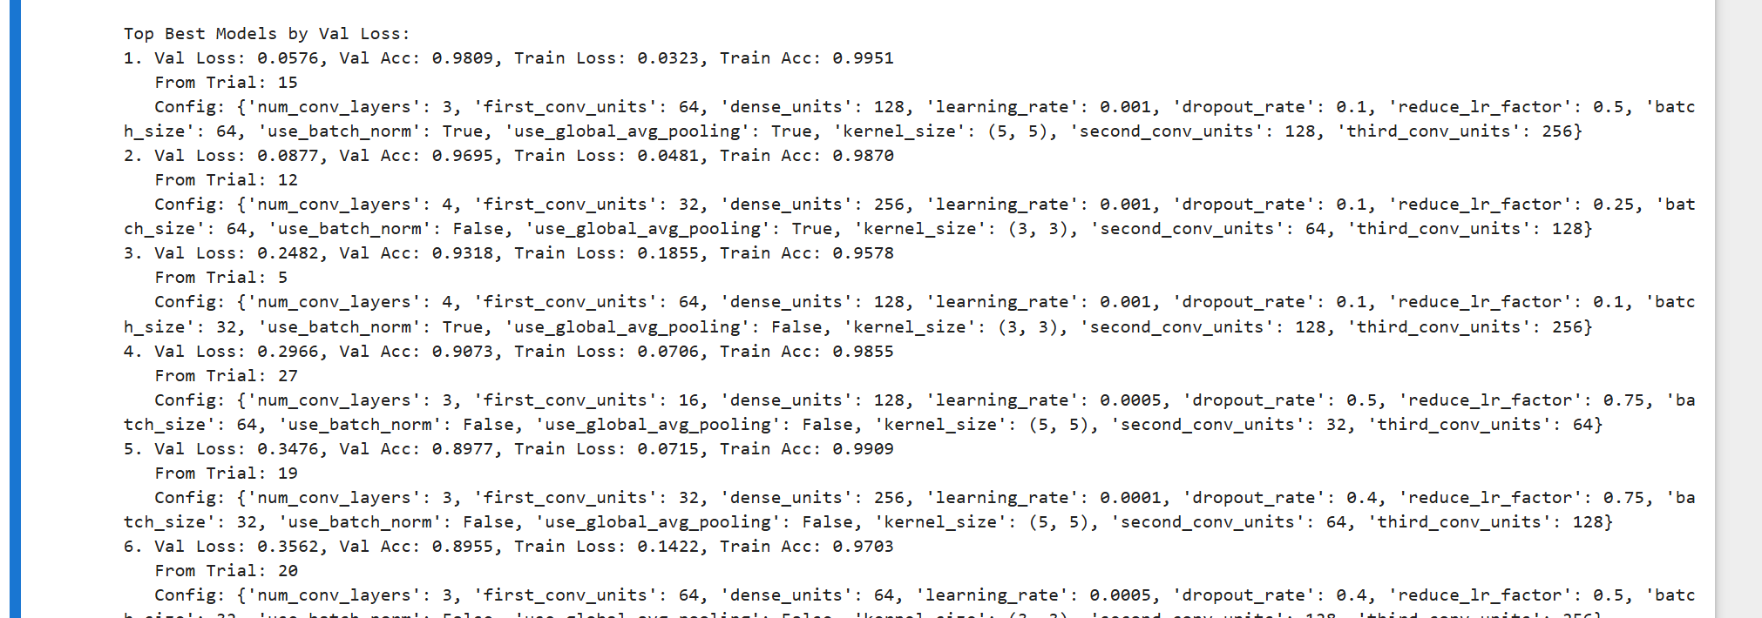
Model Improvement
23 by 23
Steps I did:
. Tune both augment and nonaugmented, use 100 epoch with 30 trials with a broad hyperparameter options.
. Also printed out the top test best and worst model and their parameters
. I evaluated and compare the best model form the augmented and non_augmented model
. See which one did better augmented or nonaugmented
. Using the knowledge of the best and worst parameters I futher tune it with the parameters and get the best model.

Slide 9
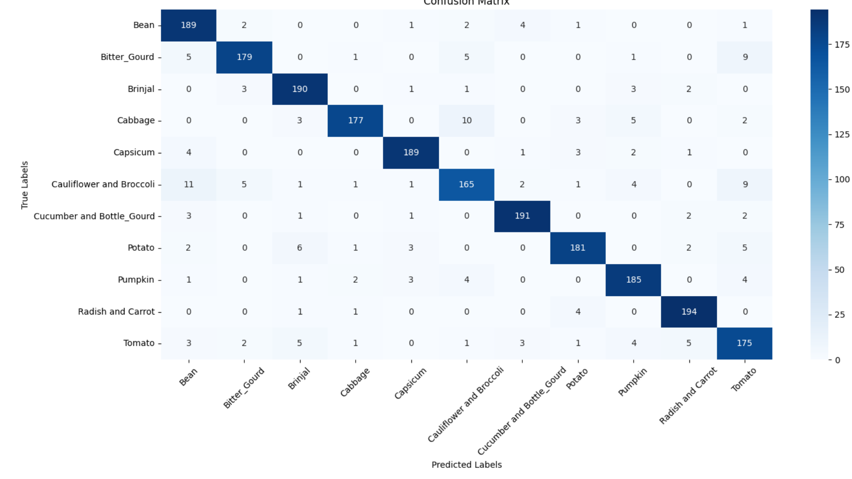
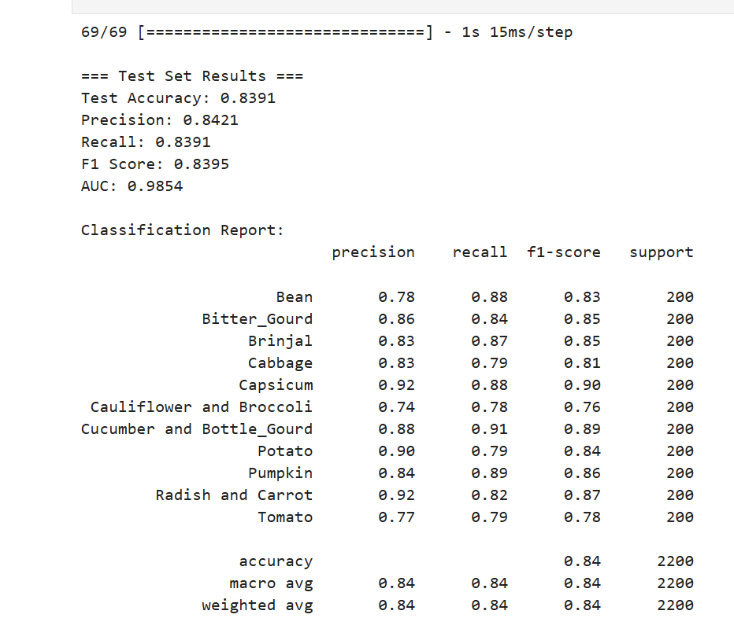
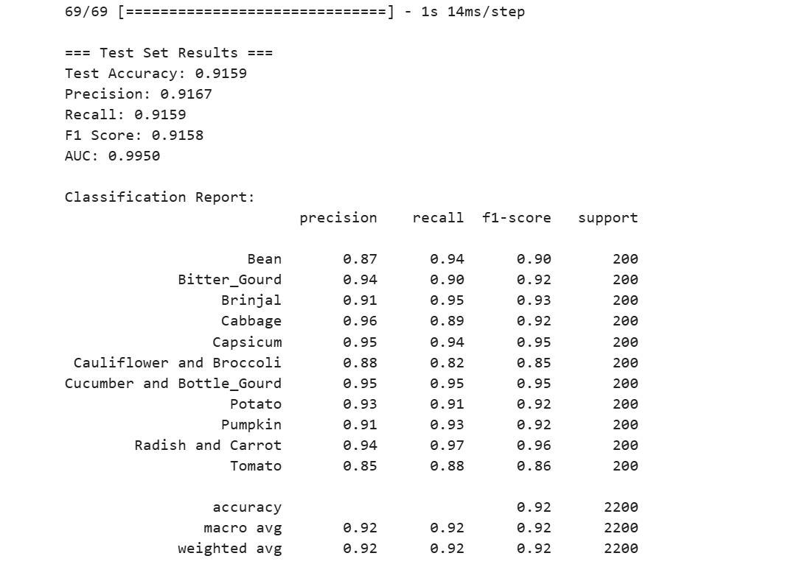
Augemented vs Non Augmented
Saw that broccoli poorly predicted, increase class weights by 1.5times for futher hyperparameter tuning
Non augmented is better based on the scores, so I futher tuned the non_augment

Slide 10
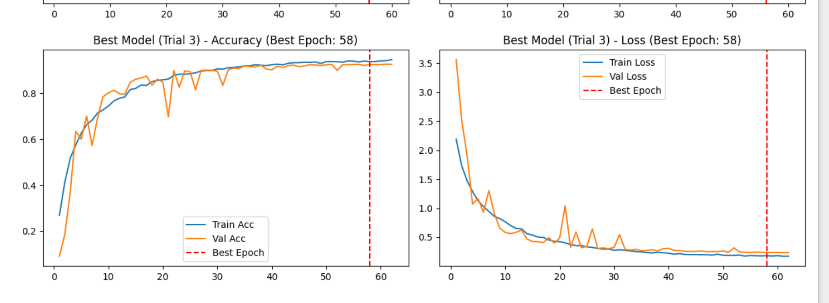
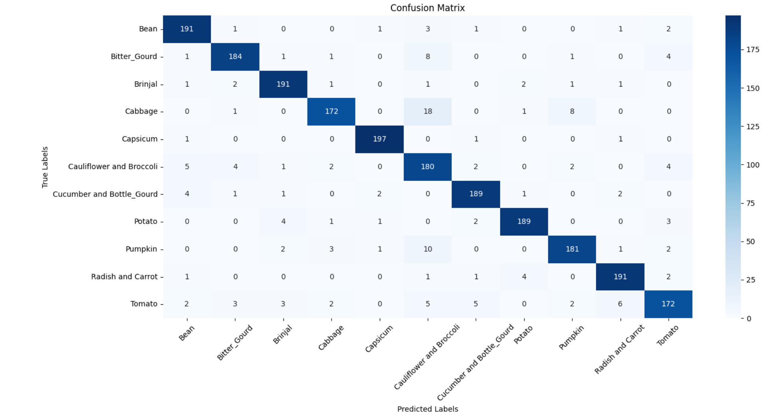
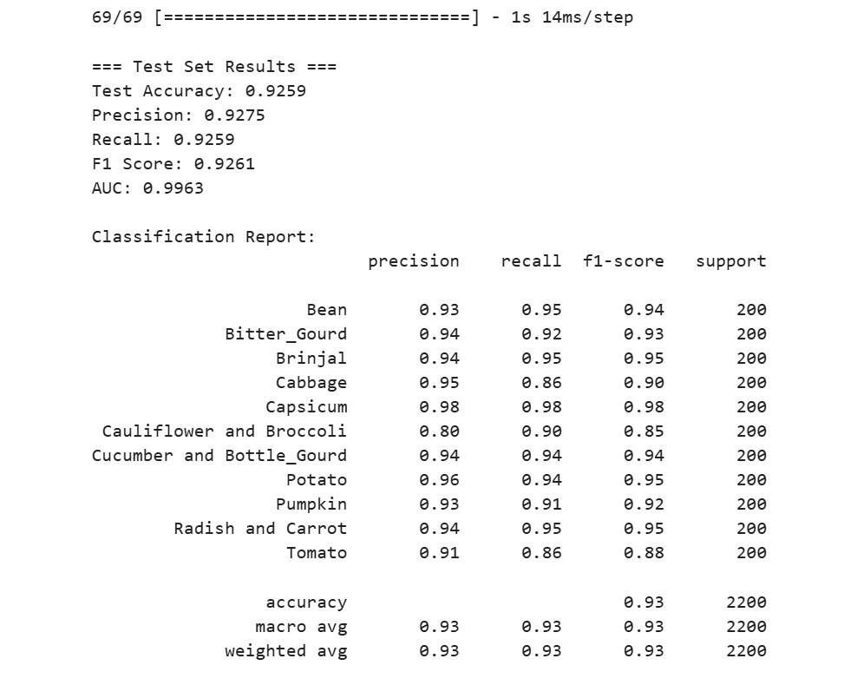
Best model 23

Slide 11
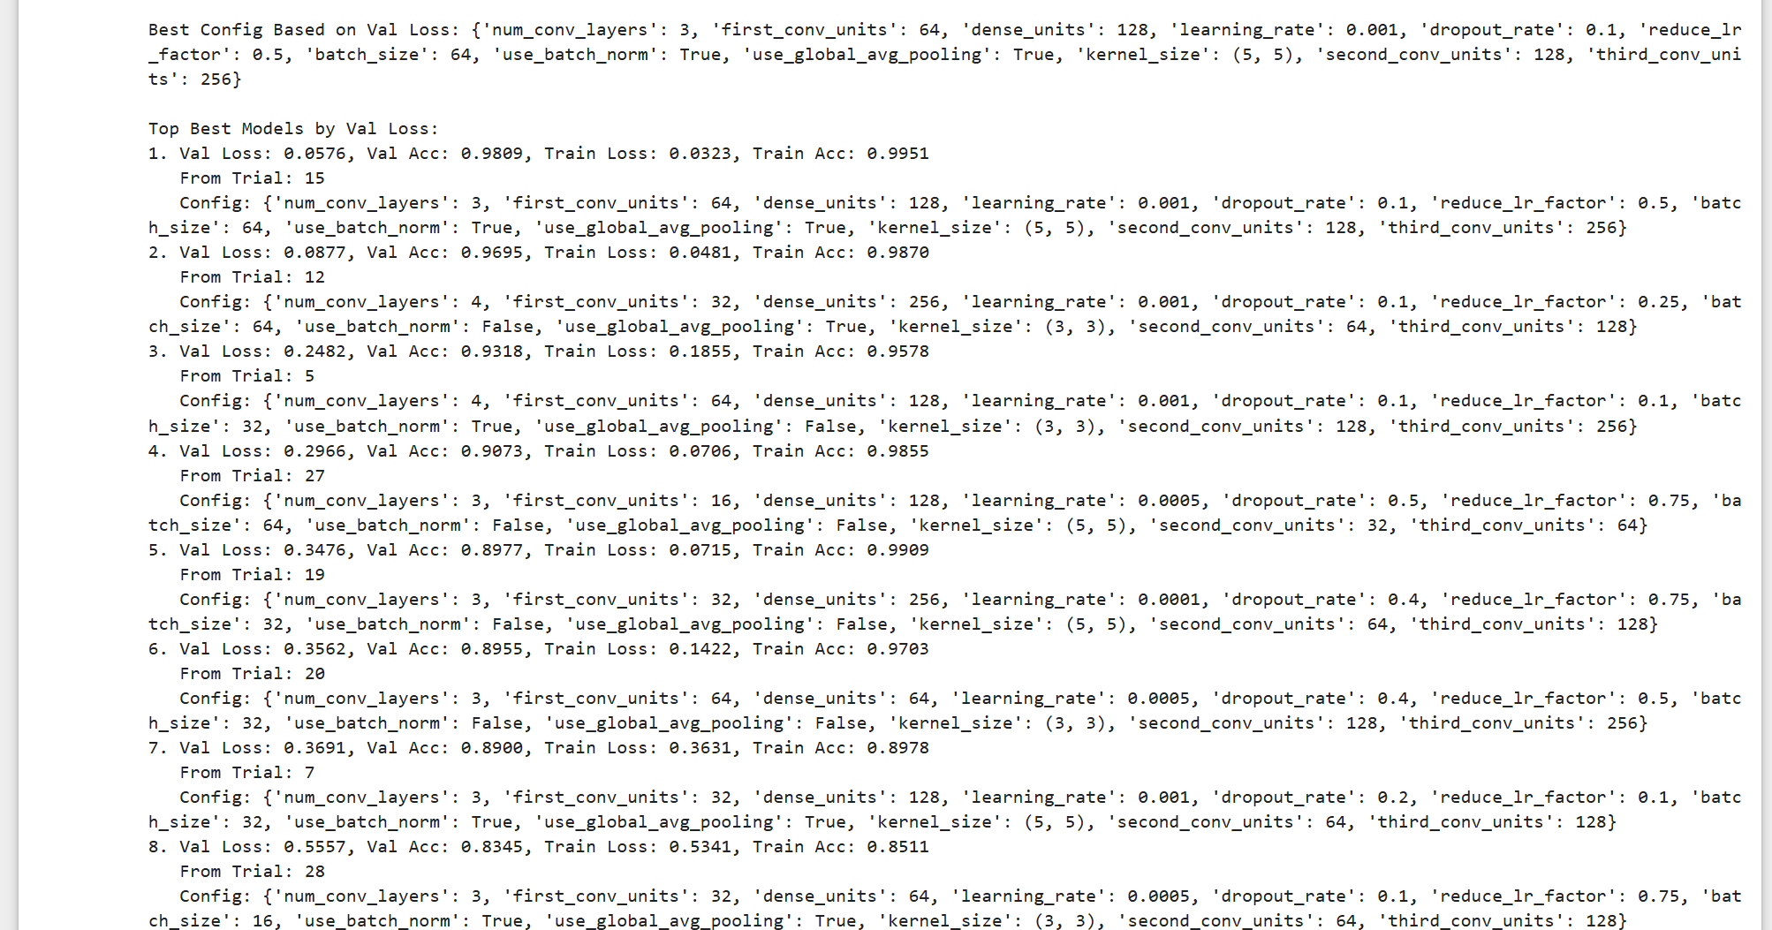
Model Improvement
101 by 101
Steps I did:
. Tune both augment and nonaugmented, use 100 epoch with 30 trials with a broad hyperparameter options.
. Also printed out the top test best and worst model and their parameters
. I evaluated and compare the best model form the augmented and non_augmented model
. See which one did better augmented or nonaugmented
. Using the knowledge of the best and worst parameters I futher tune it with the parameters and get the best model.

Slide 12
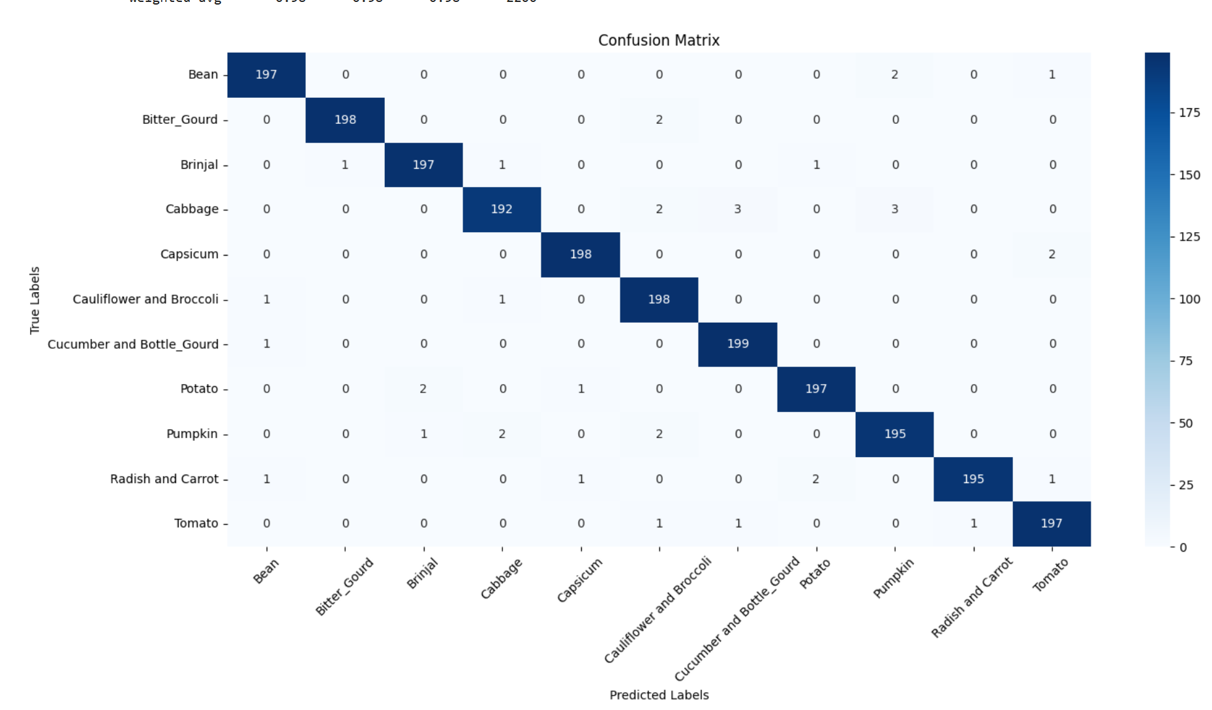
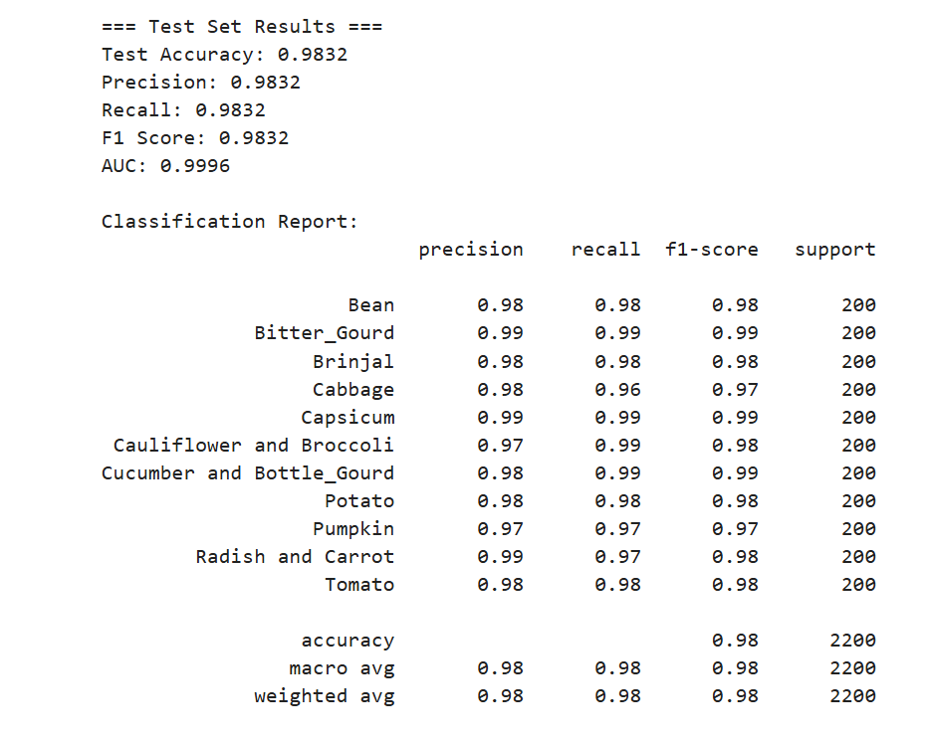
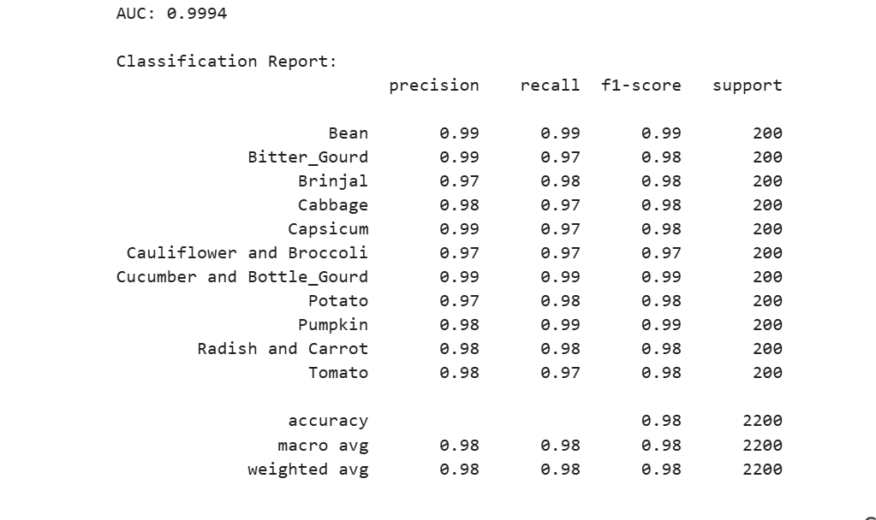
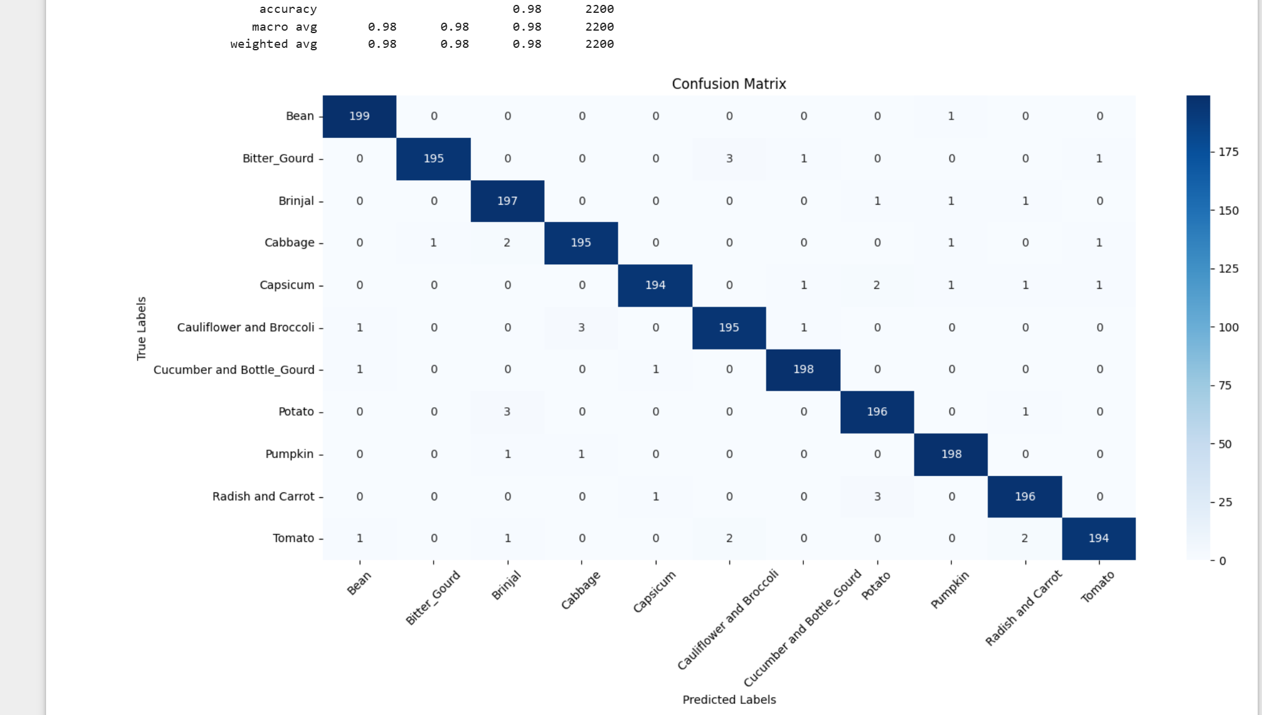
Augment
Augemented vs Non Augmented
No augment
Scores are roughly the same, so I futher tuned both

Slide 13
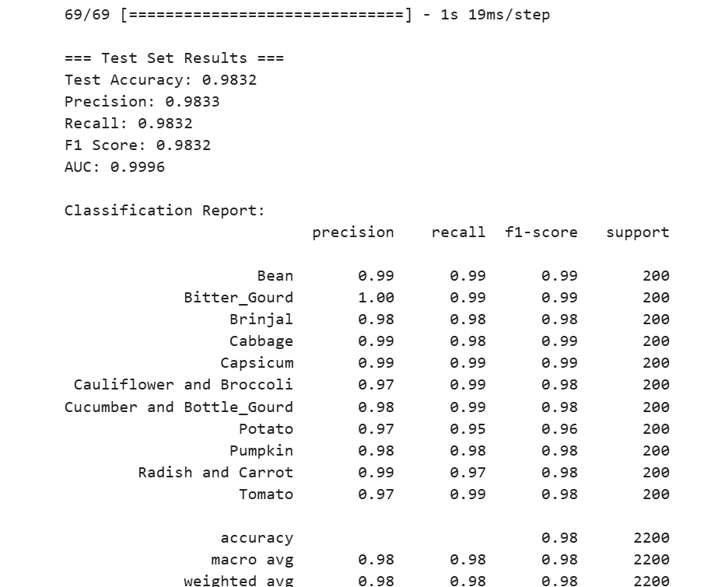
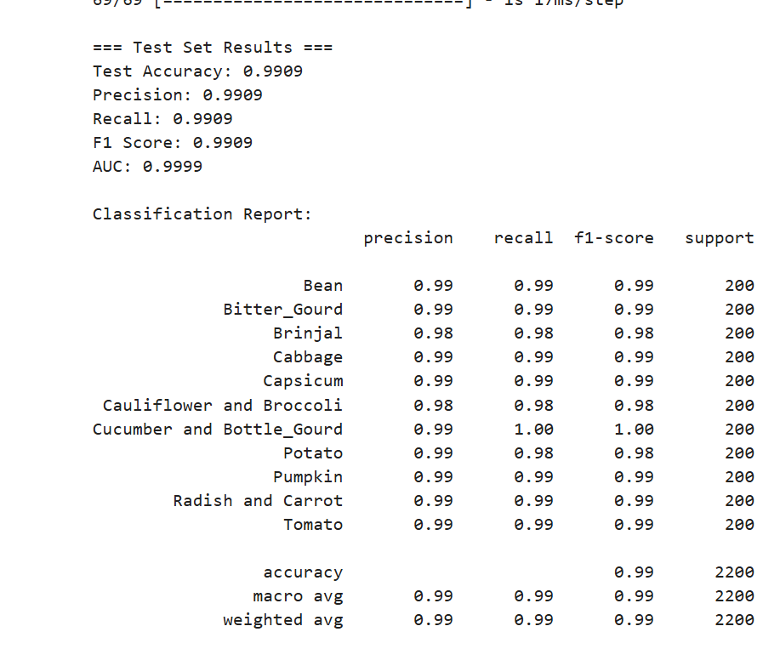
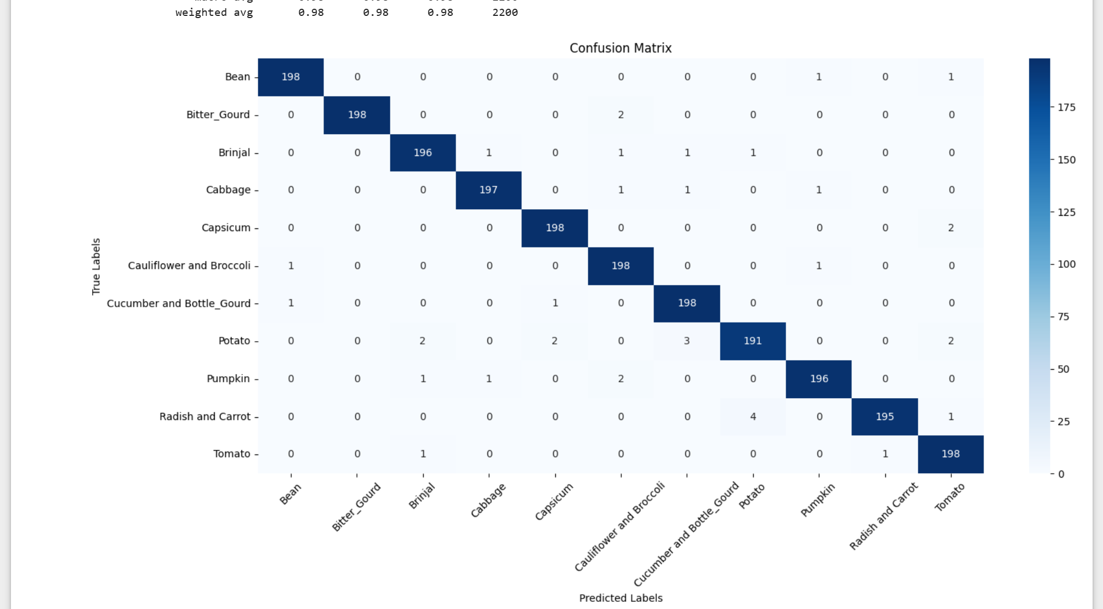
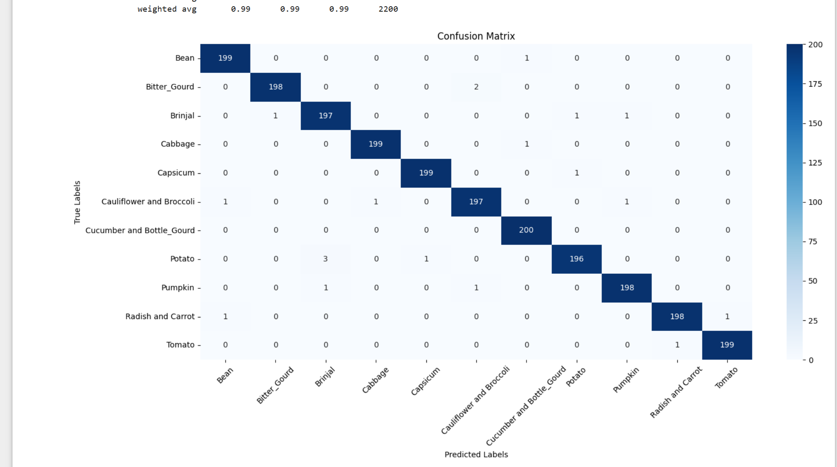
Best model101
Non_augmented
augmented
Test Accuracy:
aug: 99.09%
Non_aug : 98.32% Precision:
aug : 0.9990
Non_aug : 0.9833
Recall:
aug : 0.9990
Non_aug 0.9832 F1 Score:
aug : 0.9990
Non_aug : 0.9832 AUC:
aug : 0.9961
Non_aug : 0.9996

Slide 14
RNN presentation

Slide 15
Background info
Sentiment analysis can enhance recommendation systems by filtering content based on review sentiments,
Assist marketing campaigns by evaluating audience reactions,
Support competitive analysis by revealing strengths and weaknesses in competitors' productions.

Slide 16
DATASET EXPLORATION

Slide 17
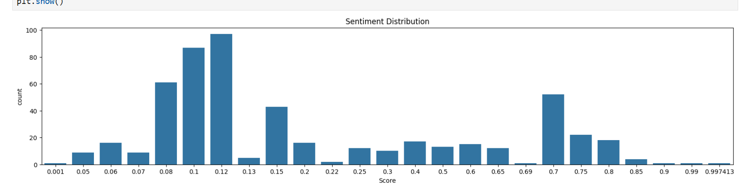
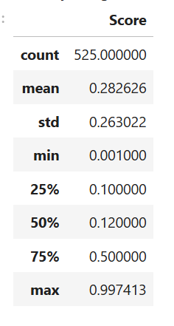
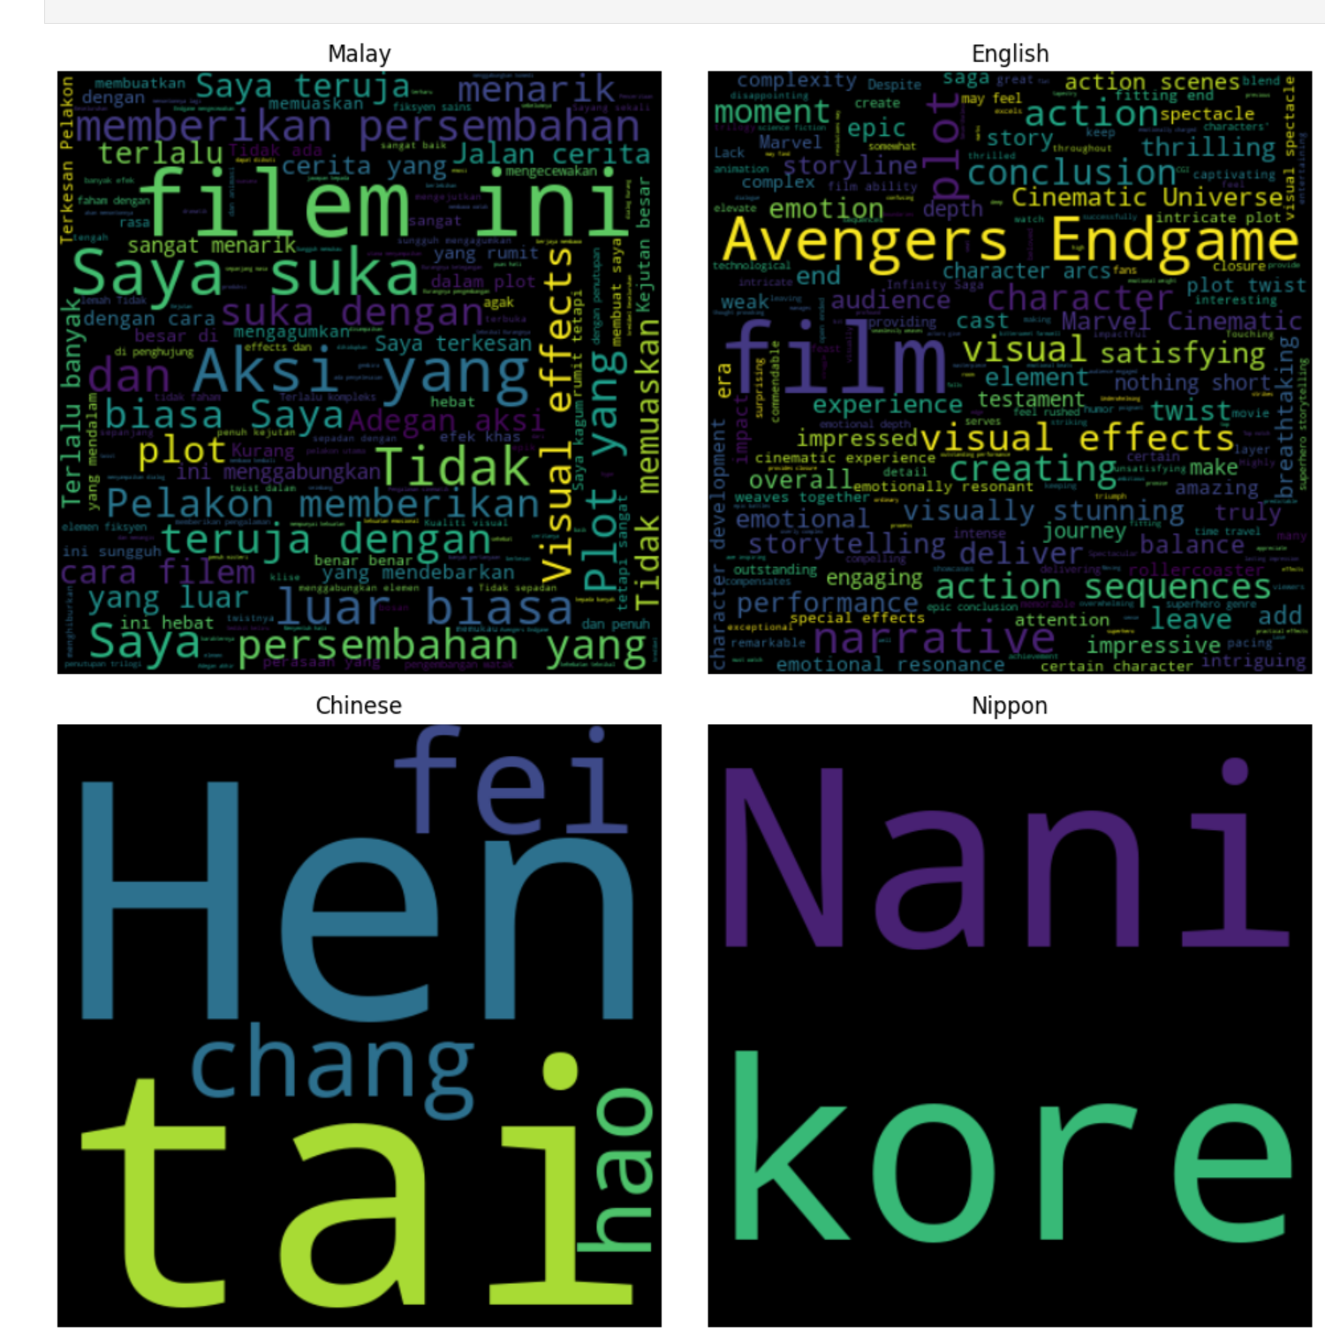
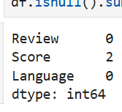
DATA INFORMATION
Dataset
Functions Used
• dataset.shape
• dataset.info()
• dataset.describe()
• dataset.isna().sum()
In our Dataset, we with NA values are of Score

Slide 18
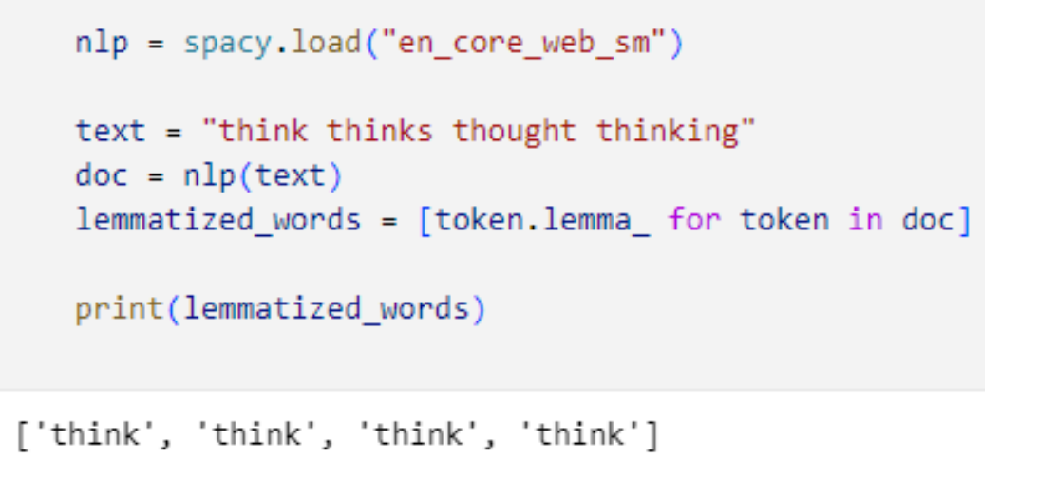
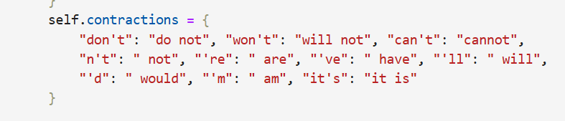
Data processing
My approach: Multilingual, Why?
Wider Applicability: process reviews in multiple languages, enhancing its global usefulness(Malay +English)
Applied Lemmatization(converts words to root form)
Applied data cleaning steps such as 1)lowercasing, 2)contraction expansion ex don’t to do not 3)URL removal
By applying these steps, I ensure that the text input to your model is consistent and free of irrelevant noise

Slide 19
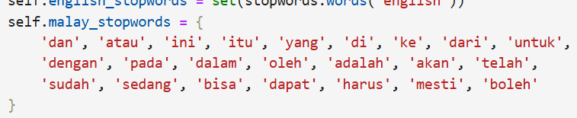
FEATURE ENGINEERING
Stopwords
. A set of commonly used words in any language. For example, in English, “the”, “is” and “and”, would easily qualify as stop words..
. For Malay I manually define stopwords to use and handle it separately from English
Data Augmentation
the process of artificially generating new data from existing data
. Synonym Replacement
. Random Swap
. Random Deletion
. Random Insertion
Only Augmented for training data
Train Test Split
carried out a 70 15 15 split

Slide 20
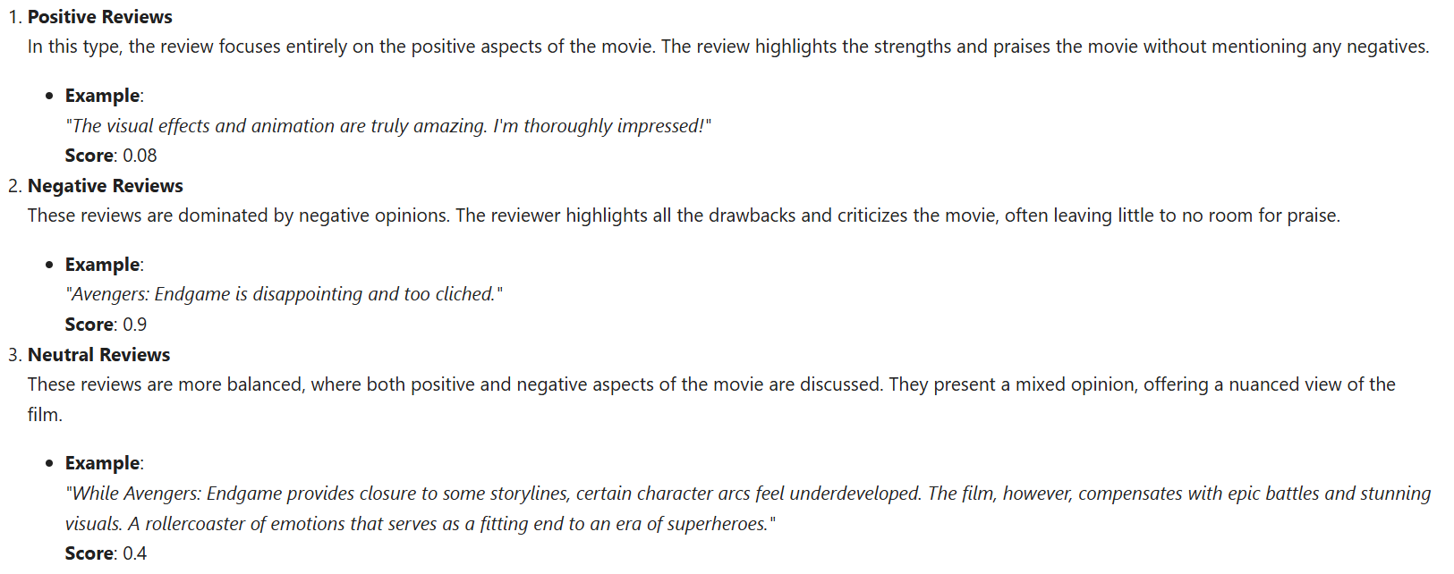
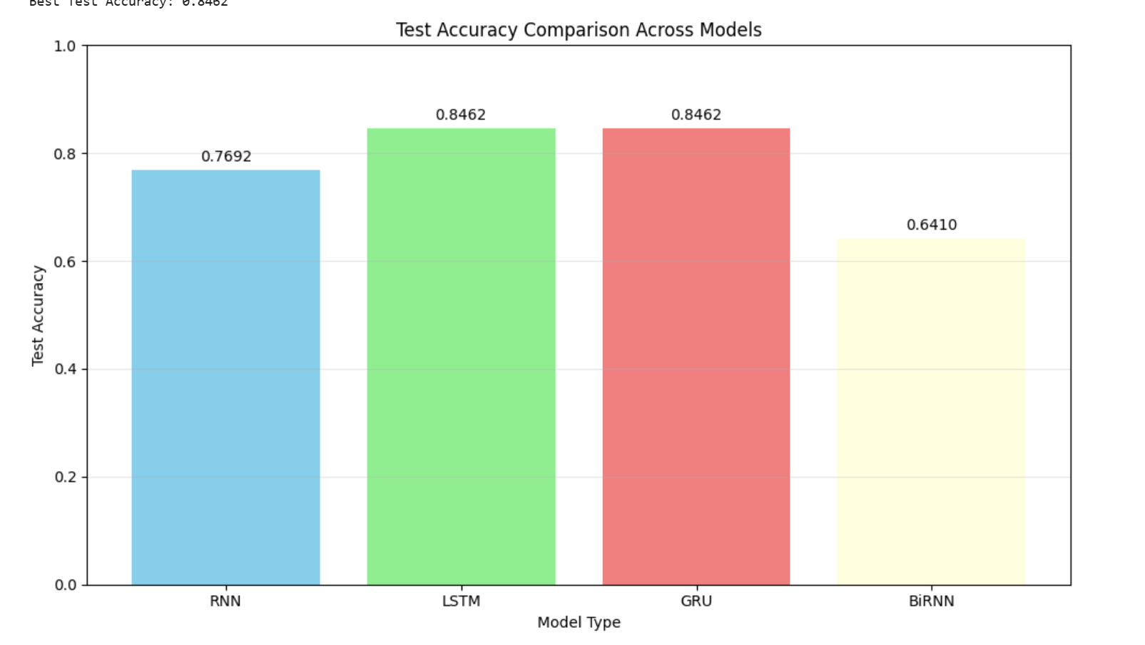
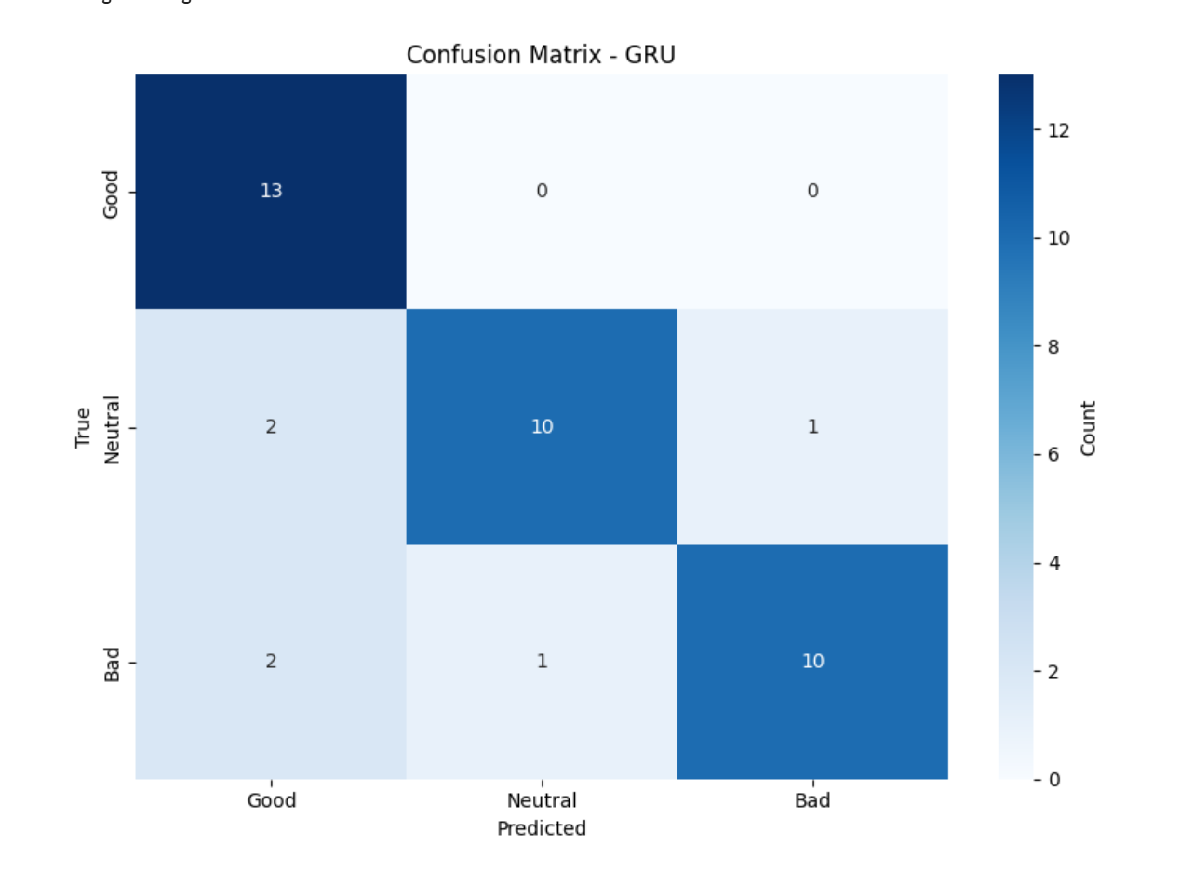
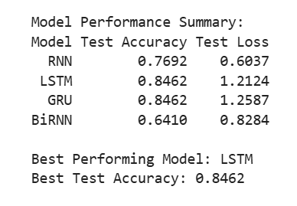
Model selection: Classification
Steps taken
. Do base model training Gru, LSTM, RNN and Bi-RNN
. See the scores and decide to do hyperparameter tuning on it.
Decided to classify based on 3 tiers Good<0.4, Neutral between 0.4 and 0.6, Bad >0.6.

Slide 21
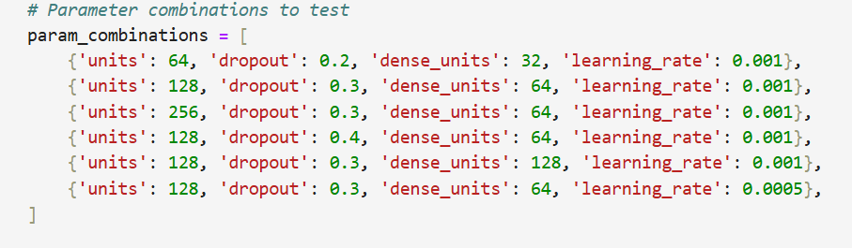
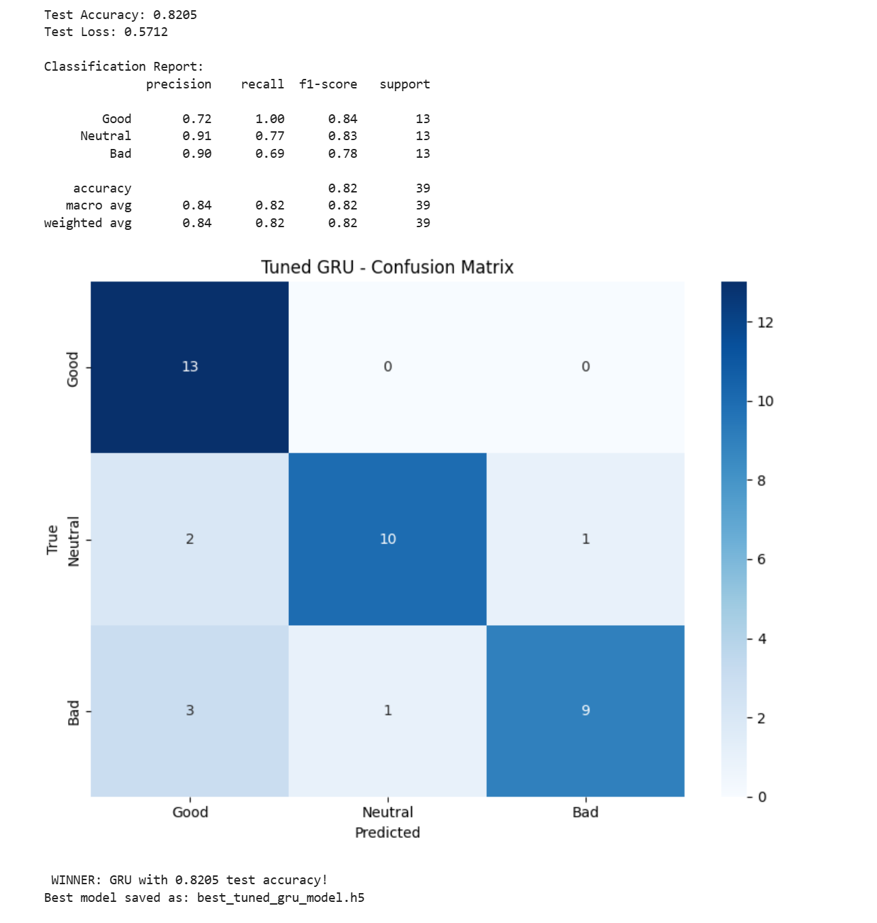
Model improvement
Firstly did Hyperparameter tuning with random search on the top 2 model from baseline, used class weights and applied it on neutral to make it predict better evaluate and saw that there was not much difference
Next I figured out that my validation data had way too little and imbalanced classes to do hyperparameter tuning since. Even though it generalizes well in validation accuracy doesnt translate to good test accuracy.
So I changed my test split to 60 20 20 so I can get more validation data, I did base line and hyperparameter tuning for the new 60 20 20 split.

Slide 22
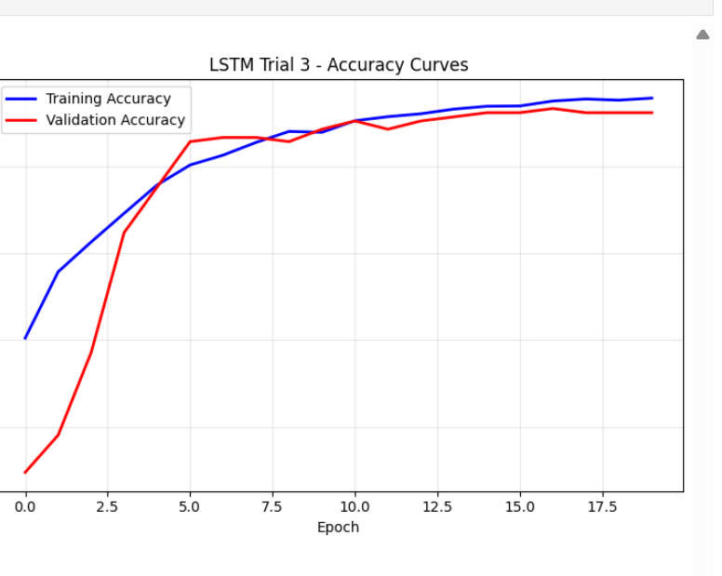
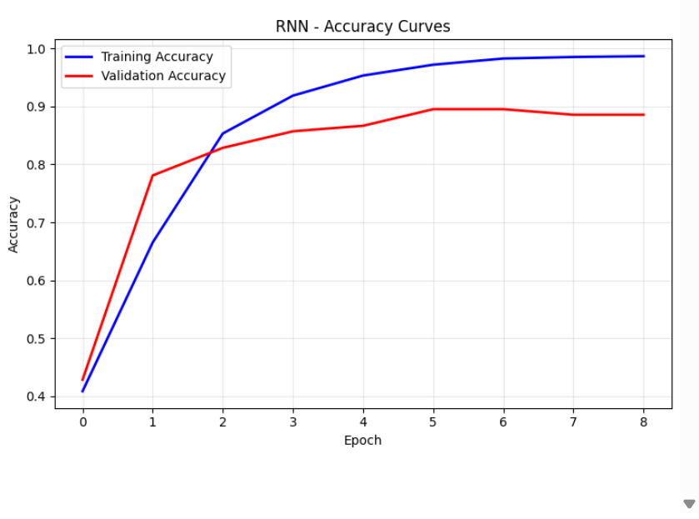
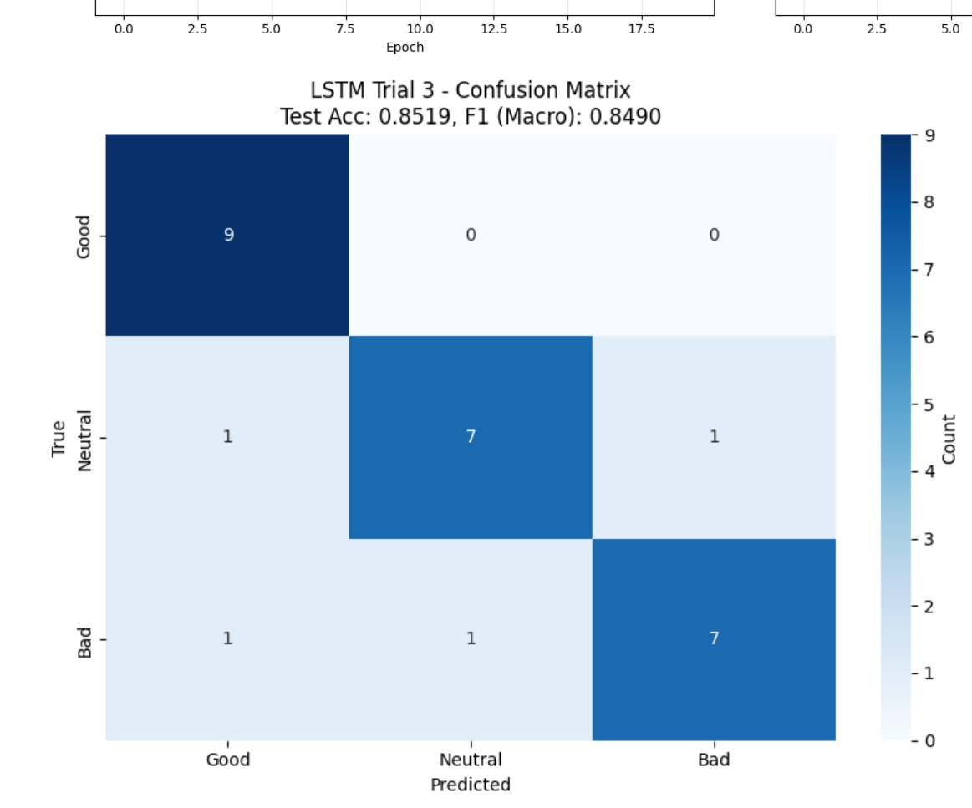
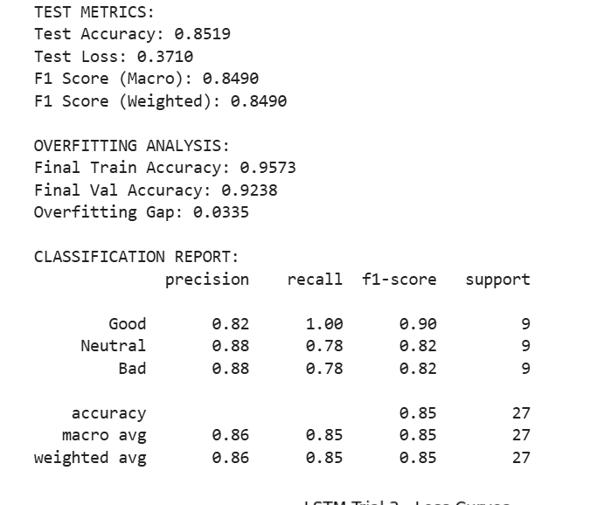
Model improvement
I realised my model shown signs of overfitting during new baseline so when I retuned my model using for 60-20-20 split I emphasized on adding higher dropout rates, batch normlisation and
Best Model after hyperparameter tuning

